Slide 1
17EECC304_Operating System and Embedded System Design Chapter-1 Introduction to Operating System

Slide 2
Course Outcome
At the end of this chapter the student should be able to:
Discuss the core structure and functionality of operating system.

Slide 3
Contents
Need for OS
What is OS?
Goals of an OS
Types of OS
Operating System Services
System Calls
Structure of OS
System Boot

Slide 4
Need for OS
Interface between the user and the computer
Managing the input/output devices
Multitasking
Platform for other application software
Development of machine independent programs/applications

Slide 5
What is OS
A program that acts as an intermediary between a user of a computer and the computer hardware
A more formal definition!
The operating system is the one program running at all times on the computer — usually called the kernel.
“Operating system is a piece of software which controls all the computer’s resources and provides the base upon which the application programs can be written”

Slide 6
So, Where your OS sits in your System?
USER
APPLICATIONS
OPERATING SYSTEM
HARDWARE

Slide 7
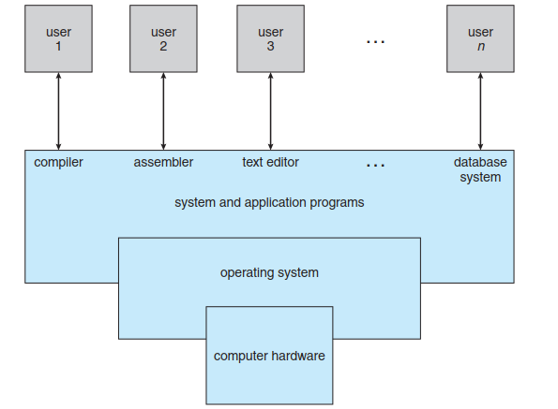
Abstract view of the components of a computer system.

Slide 8
Goals of an OS
Fundamental goals of an operating system
Efficient use of Computer Resources
User Convenience
Noninterference in the activities of its users

Slide 9
Efficient Use
OS ensures efficient use of memory, CPU, and I/O devices
Poor efficiency can result if a program does not use a resource allocated to it
OS itself consumes CPU and memory resources, which constitutes overhead
It reduces resources for user programs
OS can monitor use of resources to ensure efficiency
It would increase the overhead
OS uses policies that ensure efficiency

Slide 10
User Convenience
Facet | Examples
Fulfillment of necessity | Ability to execute programs, use the file system
Good service | Speedy response to computational requests
User friendly interfaces | Easy to commands. Graphical user interface(GUI)
Evolution | Add new features, use new technologies

Slide 11
Noninterference
Program execution or operation of OS can be disrupted by actions of other users or other os services
OS prevents interference by allocating resources for exclusive use of programs and OS services, and preventing illegal accesses to resources
Illegal file access
OS knows which user files can be accessed by whom
Achieved through authorization

Slide 12
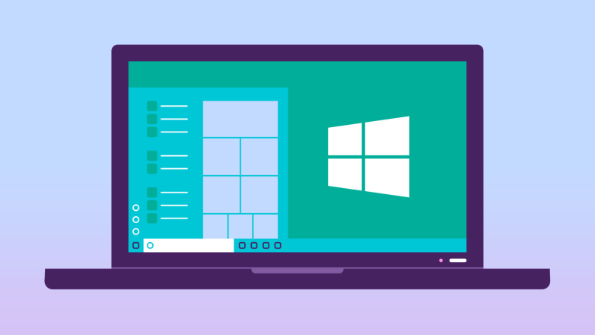

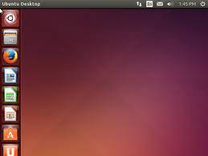
Types of Operating System
General purpose operating system (Desktops) e.g.. Mac OS, Windows, Ubuntu

Slide 13
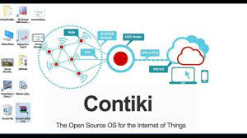
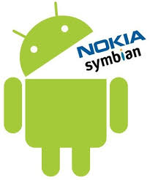
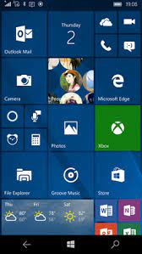
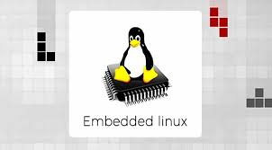
Application Specific Embedded OS e.g.. Contiki OS, Windows Mobile/CE, Symbian, Linux

Slide 14


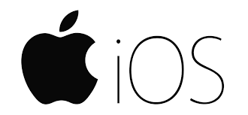
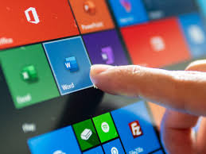
Mobile OS e.g.. Android, iOS, Ubuntu Touch, Windows Touch

Slide 15
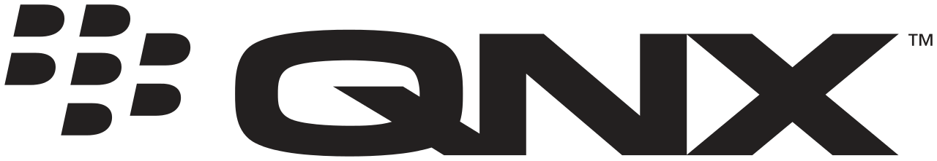

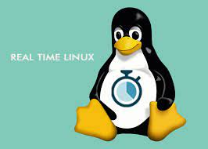
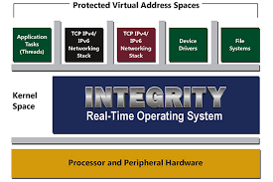
RTOS e.g. QNX, VxWorks, RTLinux, Integrity

Slide 16
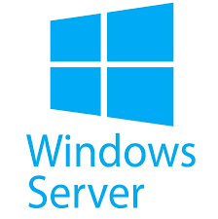
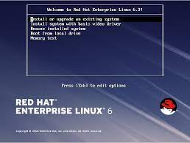
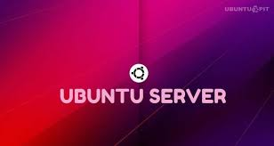
For Servers e.g.. Redhat, Ubuntu, Windows Server

Slide 17
Operating System Services
Operating systems provide an environment for execution of programs and services to programs and users
One set of operating-system services provides functions that are helpful to the user:
User interface (UI)
Command-Line (CLI), Graphics User Interface (GUI),
Program execution
The system must be able to load a program into memory and to run that program, end execution, either normally or abnormally (indicating error)
I/O operations
A running program may require I/O, which may involve a file or an I/O device

Slide 18
Operating System Services (Cont.)
File-system manipulation
Programs need to read and write files and directories, create and delete them, search them, list file Information, permission management.
Communications
Processes may exchange information, on the same computer or between computers over a network
Error detection
OS needs to be constantly aware of possible errors
May occur in the CPU and memory hardware, in I/O devices, in user program
For each type of error, OS should take the appropriate action to ensure correct and consistent computing

Slide 19
Operating System Services (Cont.)
Another set of OS functions exists for ensuring the efficient operation of the system itself via resource sharing
Resource allocation
When multiple users or multiple jobs running concurrently, resources must be allocated to each of them.
Many types of resources - CPU cycles, main memory, file storage, I/O devices
Accounting
To keep track of which users use how much and what kinds of computer resources
Protection and security
Protection involves ensuring that all access to system resources is controlled
Security of the system from outsiders requires user authentication, extends to defending external I/O devices from invalid access attempts

Slide 20
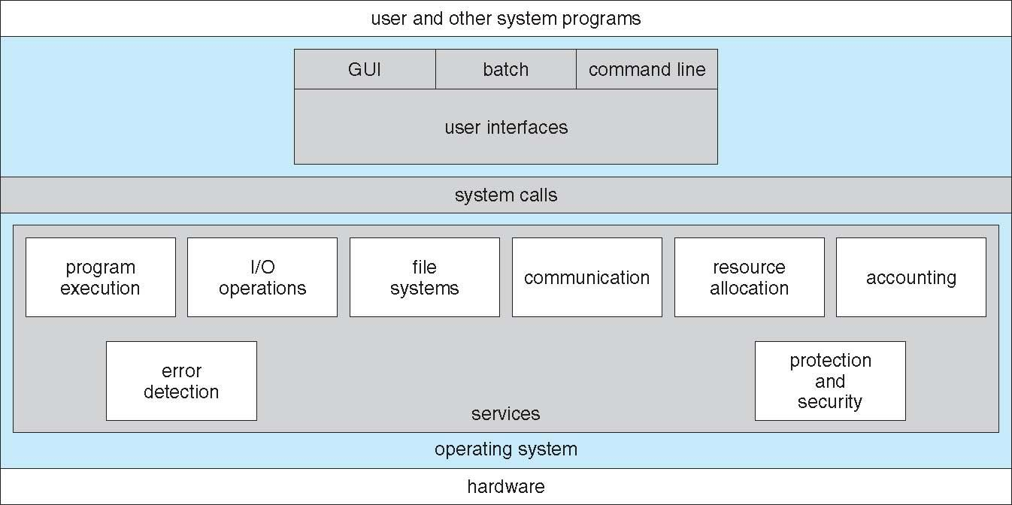
A View of Operating System Services

Slide 21
System Calls
Programming interface to the services provided by the OS
Typically written in a high-level language (C or C++)
Mostly accessed by programs via a high-level Application Programming Interface (API) rather than direct system call use
Three most common APIs are
Win32 API for Windows,
POSIX API for POSIX-based systems (UNIX, Linux, and Mac OS X),
Java API for the Java virtual machine (JVM)

Slide 22
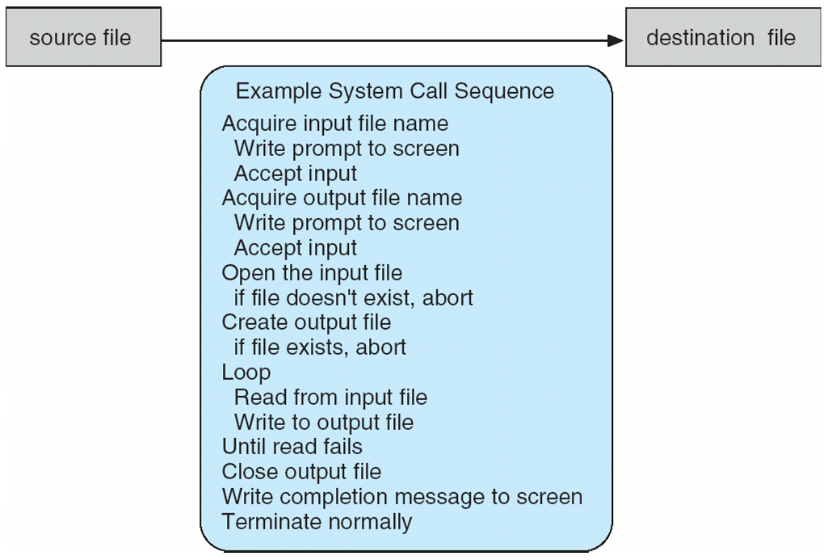
Example of System Calls
System call sequence to copy the contents of one file to another file

Slide 23
System Call Implementation
Typically, a number associated with each system call
System-call interface maintains a table indexed according to these numbers
The system call interface invokes the intended system call in OS kernel and returns status of the system call and any return values
The caller need know nothing about how the system call is implemented

Slide 24
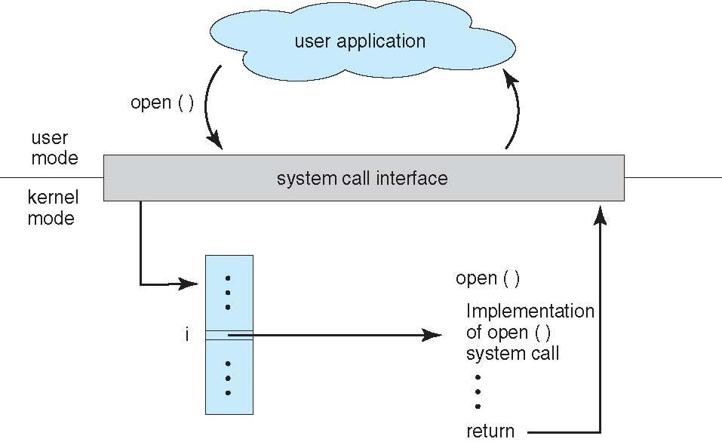
API – System Call – OS Relationship

Slide 25
Types of System Calls
Process control
create process, terminate process
end, abort
load, execute
get process attributes, set process attributes
wait for time
wait event, signal event
allocate and free memory
Dump memory if error
Debugger for determining bugs, single step execution
Locks for managing access to shared data between processes

Slide 26
Types of System Calls (Cont.)
File management
create file, delete file
open, close file
read, write, reposition
get and set file attributes
Device management
request device, release device
read, write, reposition
get device attributes, set device attributes
logically attach or detach devices

Slide 27
Types of System Calls (Cont.)
Information maintenance
get time or date, set time or date
get system data, set system data
get and set process, file, or device attributes
Communications
create, delete communication connection
send, receive messages if message passing model to host name or process name
From client to server
Shared-memory model create and gain access to memory regions
transfer status information
attach and detach remote devices

Slide 28
Types of System Calls (Cont.)
Protection
Control access to resources
Get and set permissions
Allow and deny user access

Slide 29
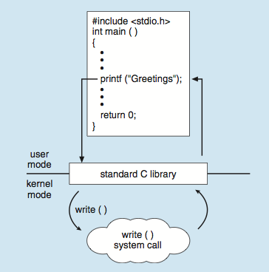
Standard C Library Example
C program invoking printf() library call, which calls write() system call

Slide 30
Operating System Structure
General-purpose OS is very large program
Various ways to structure ones
Simple structure – MS-DOS
More complex -- UNIX
Layered – an abstraction
Microkernel -Mach

Slide 31
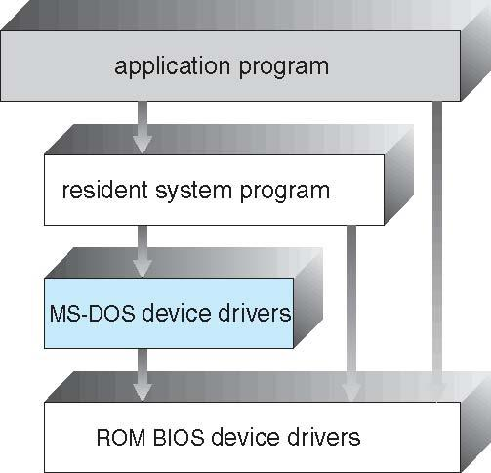
Simple Structure -- MS-DOS
MS-DOS – written to provide the most functionality in the least space
Not divided into modules
MS-DOS operating system is split into various layers and each of the layers have different functionalities

Slide 32
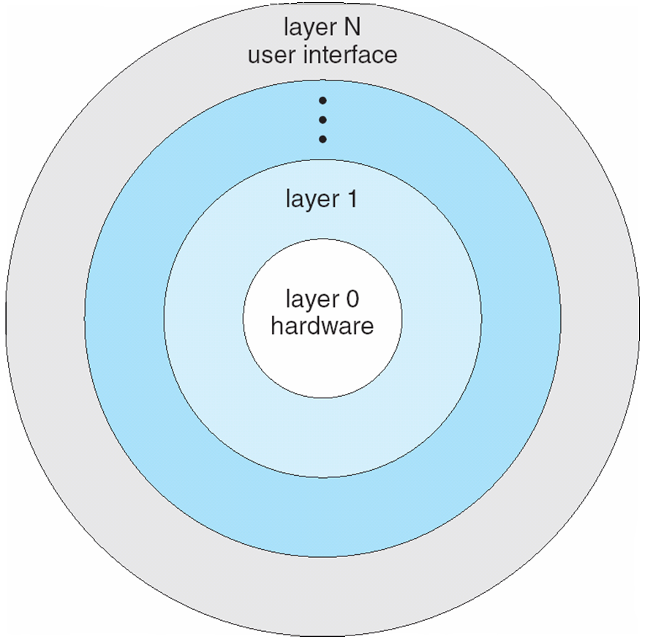
Layered Approach
The operating system is divided into a number of layers (levels), each built on top of lower layers. The bottom layer (layer 0), is the hardware; the highest (layer N) is the user interface.
With modularity, layers are selected such that each uses functions (operations) and services of only lower-level layers

Slide 33
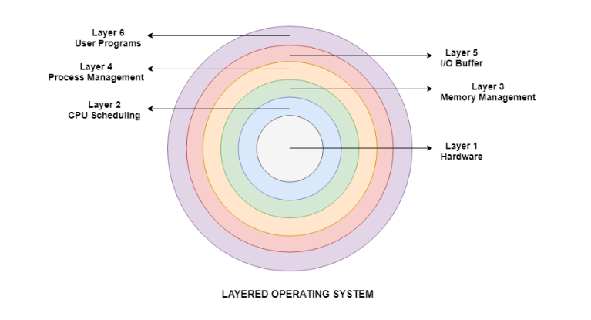
Layered Approach

Slide 34
Non Simple Structure -- UNIX
Unix is a multiuser, multitasking operating system that was developed by Bell Laboratories in 1969.
The main components of the Unix operating system structure are the kernel layer, the shell layer and the application layer

Slide 35
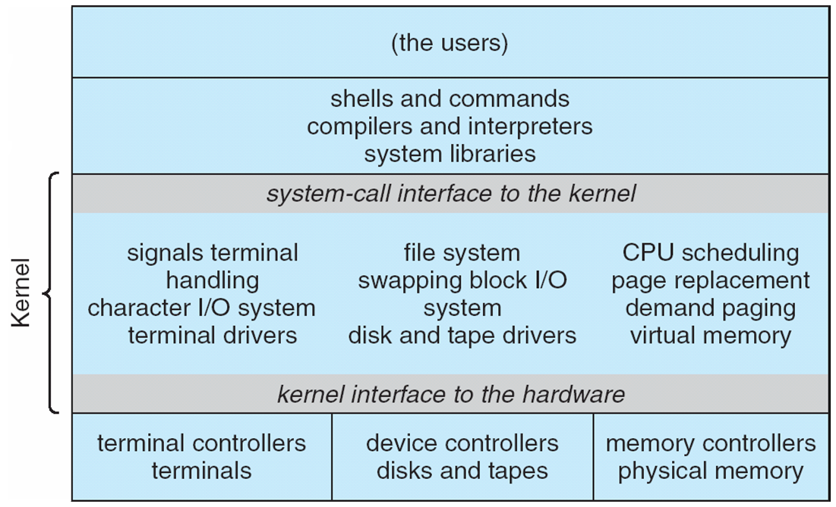
Traditional UNIX System Structure
Beyond simple but not fully layered

Slide 36
Non Simple Structure -- UNIX
Kernel
The kernel provides a bridge between the hardware and the user.
Shell
The program between the user and the kernel is known as the shell. It translates the many commands that are typed into the terminal session.
Applications
The applications and utility layer in Unix includes the word processors, graphics programs, database management programs, commands etc.

Slide 37
Monolithic Structure
It is the oldest architecture of the operating system.
All the basic services of OS like process management, file management, memory management, exception handling, process communication etc. are all present inside the kernel only.
Linux is a good example of monolithic kernel.

Slide 38
Monolithic Structure Contd..
Advantages of Monolithic Architecture:
Simple and easy to implement structure
Faster execution due to direct access to all the services
Disadvantages of Monolithic Architecture:
Addition of new features or removal of obsolete features is very difficult.
Security issues are always there because there is no isolation among various servers’ present in the kernel.

Slide 39
Microkernel System Structure
A microkernel contains only the core functionalities of the system. All the other non-essential components are put in the user mode.
Kernel is the core part of an operating system which manages system resources. It also acts like a bridge between application and hardware of the computer
The user services and kernel services are implemented in different address space.
The minimum functionalities included in the microkernel are
Memory management
Processor scheduling mechanisms
Inter-process communication

Slide 40
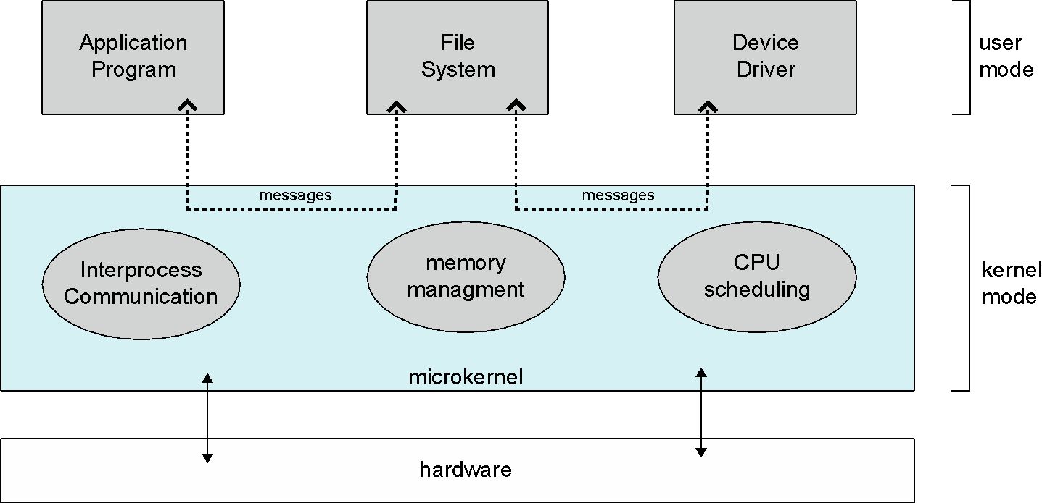
Microkernel System Structure

Slide 41
Microkernel System Structure Contd..
Advantages of Microkernel –
The architecture of this kernel is small and isolated hence it can function better.
Expansion of the system is easier, it is simply added in the system application without disturbing the kernel.

Slide 42
Basis for Comparison | Microkernel | Monolithic Kernel
Basic | In microkernel user services and kernel, services are kept in separate address space. | In monolithic kernel, both user services and kernel services are kept in the same address space.
Size | Microkernel are smaller in size. | Monolithic kernel is larger than microkernel.
Execution | Slow execution. | Fast execution.
Extendible | The microkernel is easily extendible. | The monolithic kernel is hard to extend.
Security | If a service crashes, it does effect on working of microkernel. | If a service crashes, the whole system crashes in monolithic kernel.
Code | To write a microkernel, more code is required. | To write a monolithic kernel, less code is required.
Example | QNX, Symbian, L4Linux, Singularity, K42, Mac OS X, Integrity, PikeOS, HURD, Minix, and Coyotos. | Linux, BSDs (FreeBSD, OpenBSD, NetBSD), Microsoft Windows (95,98,Me), Solaris, OS-9, AIX, HP-UX, DOS, OpenVMS, XTS-400 etc.

Slide 43
System Boot
When power initialized on system, execution starts at a fixed memory location
Firmware ROM used to hold initial boot code
Operating system must be made available to hardware so hardware can start it
Small piece of code – bootstrap loader, stored in ROM or EEPROM locates the kernel, loads it into memory, and starts it
Sometimes two-step process where boot block at fixed location loaded by ROM code, which loads bootstrap loader from disk
Common bootstrap loader, GRUB, allows selection of kernel from multiple disks, versions, kernel options
Kernel loads and system is then running

Slide 44
Summary
OS services programs simultaneously by allocating some of the resources to each program and interleaving their execution on the CPU
Requirements to ensure effectiveness of computing:
Efficient use
User convenience
Non-interference
Primary functions
Management of programs
Management of resources
Security and protection
Different Structures
Simple
Layered
Monolithic
Microkernel

Slide 45
References:
Abraham Silberschatz, Greg Gagne, and Peter Baer Galvin, "Operating System Concepts, Ninth Edition “
Operating Systems, by Dhananjay Dhamdhere

Slide 46
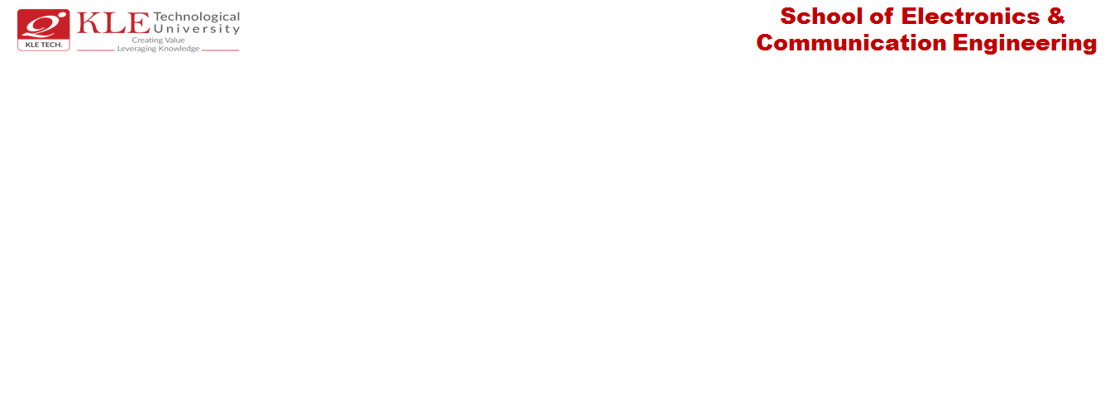
Thank you

